Slide 1
MinneMUDAC 2019
Team U27
Manasi Paste
Marc Mascarenhas
Shashwati Shradha
Notes:
The goal of the competition for us was to help inform farmers about financial trends in the soybean market.
We did this by first
Analyzing the soybean market in the USA
And then,
Make predictions for Soybean closing for 3 different contract months for this last week.

Slide 2
Overview
EXPLORATION
METHODOLOGY
PREDICTIONS
CONCLUSION

Slide 3
EXPLORATION
1

Slide 4
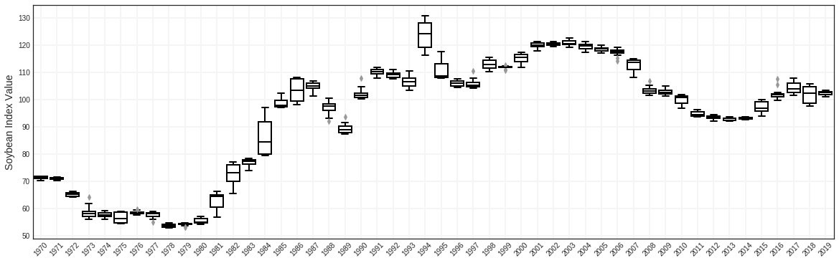
Soybean Commodity Exchange Rate Index
Notes:
One way to measure how competitive the US Soybean export market is, is by the Commodity exchange rate index - To understand how this has changed over the years, we looked at the yearly distributions of the index from 1970 - 2019. While most of the years have had little fluctuation, there have been some years which have had great volatility - like the 1970’s & 1990’s due to emergence of competitors & agro chem resp; the financial crisis in 2007 and the trade wars that are going on currently.

Slide 5
Soybean Commodity Exchange Rate Index
Financial Crisis
NAFTA
Agrochemicals
Emergence of
Competitors
Trade Wars
Notes:
One way to measure how competitive the US Soybean export market is, is by the Commodity exchange rate index - To understand how this has changed over the years, we looked at the yearly distributions of the index from 1970 - 2019. While most of the years have had little fluctuation, there have been some years which have had great volatility - like the 1970’s & 1990’s due to emergence of competitors & agro chem resp; the financial crisis in 2007 and the trade wars that are going on currently.

Slide 6
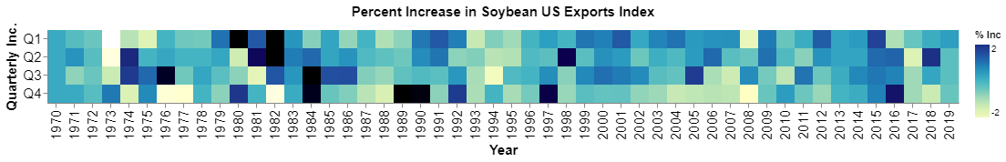
Soybean Commodity Exchange Rate Index
Financial Crisis
NAFTA
Agrochemicals
Emergence of
Competitors
Trade Wars
Notes:
One way to measure how competitive the US Soybean export market is, is by the Commodity exchange rate index - To understand how this has changed over the years, we looked at the yearly distributions of the index from 1970 - 2019. While most of the years have had little fluctuation, there have been some years which have had great volatility - like the 1970’s & 1990’s due to emergence of competitors & agro chem resp; the financial crisis in 2007 and the trade wars that are going on currently.

Slide 7
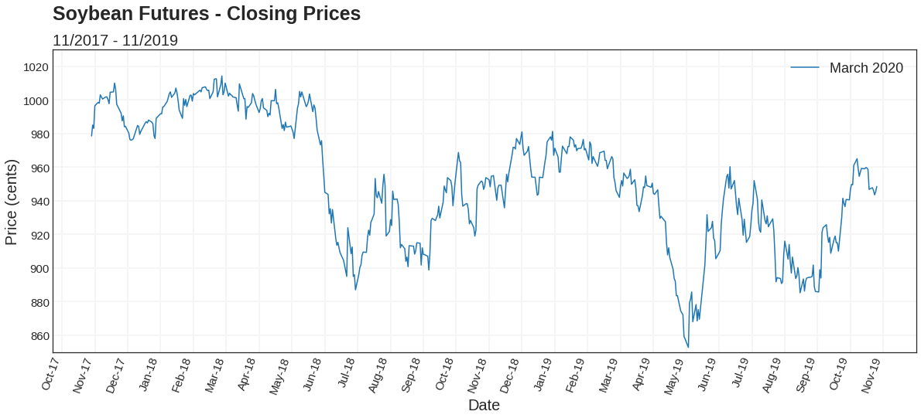
Futures Contracts
Notes:
We then looked at futures contracts -
So what exactly is a futures contract? It’s basically an agreement to sell soybean at a fixed price at a later date. Knowing whens a high/low helps the farmer know when's the best time to sell
We looked at contracts for March,May and July 2020
The graph here shows the historical trend of the futures price for March 2020
Similarly, we can also see the trend for May and July 2020 - as you can see the trends are very similar with july always higher than the other 2 - one potential reason for this could be that since its further out , it would cost more

Slide 8
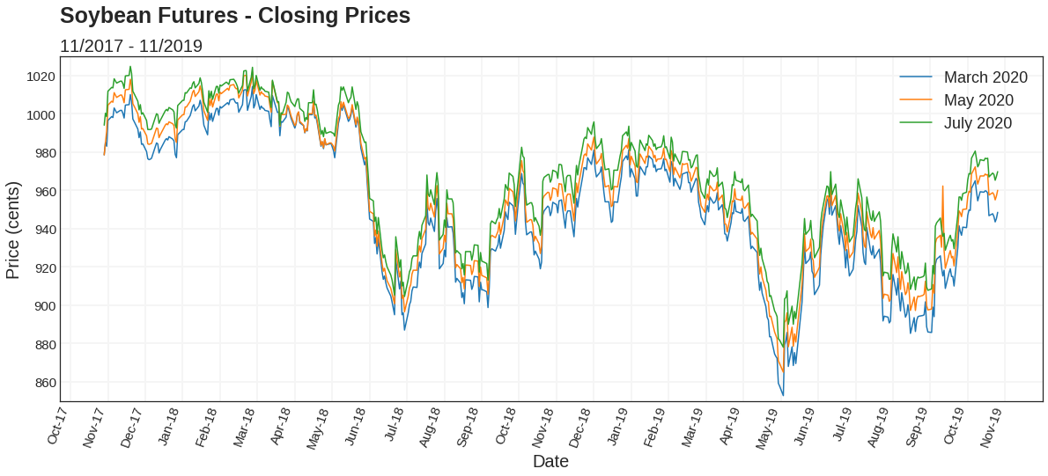
Futures Contracts
Notes:
So what exactly is a futures contract? It’s basically an agreement to sell soybean at a fixed price at a later date. Knowing whens a high/low helps the farmer know whens the best time to sell
We looked at contracts for March,May and July 2020
The graph here shows the historical trend of the futures price for March 2020
Similarly, we can also see the trend for May and July 2020 - as you can see the trends are very similar with july always higher than the other 2 - one potential reason for this could be that since its further out , it would cost more

Slide 9
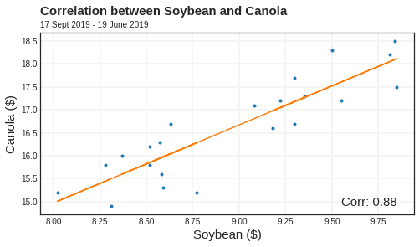
Interesting Findings
Seasonality
Canola price
Delayed Seeding
Notes:
Seasonality graphs: Dickie fuller algo:
Canola Prices: Due to similar factors in

Slide 10
METHODOLOGY
2

Slide 11
Goals
TRAINING
VALIDATION
PREDICTION
17 Nov '17
19 July '19
22 July '19
1 Nov '19
4 Nov '19
8 Nov '19
CONTRACT MONTHS: March 2020, May 2020, July 2020
MINIMIZE:
EVALUATION: Time-series Cross Validation - Rolling Forecasting
Notes:
We collected additional eod closing prices; and cleaned the data ( filled in missing days)
Since we were predicting 5 continuous days - there were 2 ways that we approach the problem
Predicting 5 days at a time
Predicting one day at a time and using the prediction as input to predict the next day
*Insert image explaining process
To evaluate our models - a cross validation technique where the model was evaluated on a rolling forecasting origin
The goal of the competition was to predict the closing prices for this last week for 3 contract months - the March 2020

Slide 12
Approach
METHOD 1:
METHOD 2:
N
1
N
5
N
1
N
1
N
1
N
1

Slide 13
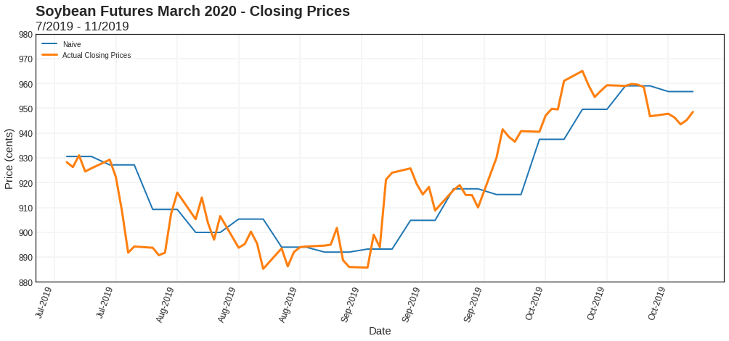
Models
METHOD | NAIVE | MOVING AVERAGE (MA) | EXPONENTIAL MA | LSTM | SARIMA | FINAL
MAE/week | 48.8 ¢ | 8.52 | 8.72
Notes:
We came up with a baseline naive model ( averaged the prev week as the price of the next week)
Our models tried to minimize the MAE Loss over the 3 months
*insert formula*
We then improved on this through
MA,
EMA (noise),
SARIMA,
LSTM
To see how good our models were, we tested it on 15 weeks from July 22 to Nov 1
* Insert graph on this model
* Correlation matrix*

Slide 14
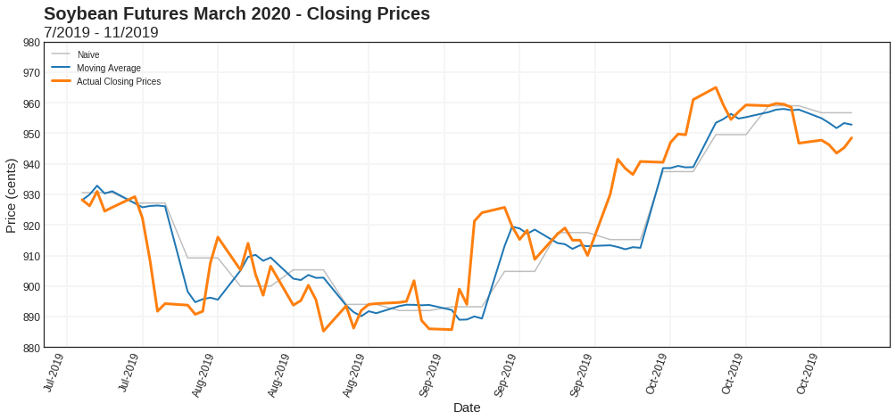
Models
METHOD | NAIVE | MOVING AVERAGE (MA) | EXPONENTIAL MA | LSTM | SARIMA | FINAL
MAE/week | 48.8 ¢ | 42.6 ¢ | 8.72
Notes:
We came up with a baseline naive model ( averaged the prev week as the price of the next week)
Our models tried to minimize the MAE Loss over the 3 months
*insert formula*
We then improved on this through
MA,
EMA (noise),
SARIMA,
LSTM
To see how good our models were, we tested it on 15 weeks from July 22 to Nov 1
* Insert graph on this model
* Correlation matrix*

Slide 15
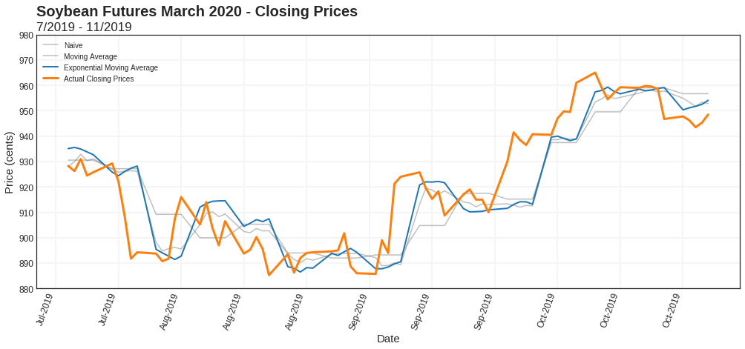
Models
METHOD | NAIVE | MOVING AVERAGE (MA) | EXPONENTIAL MA | LSTM | SARIMA | FINAL
MAE/week | 48.8 ¢ | 42.6 ¢ | 43.6 ¢
Notes:
We came up with a baseline naive model ( averaged the prev week as the price of the next week)
Our models tried to minimize the MAE Loss over the 3 months
*insert formula*
We then improved on this through
MA,
EMA (noise),
SARIMA,
LSTM
To see how good our models were, we tested it on 15 weeks from July 22 to Nov 1
* Insert graph on this model
* Correlation matrix*

Slide 16
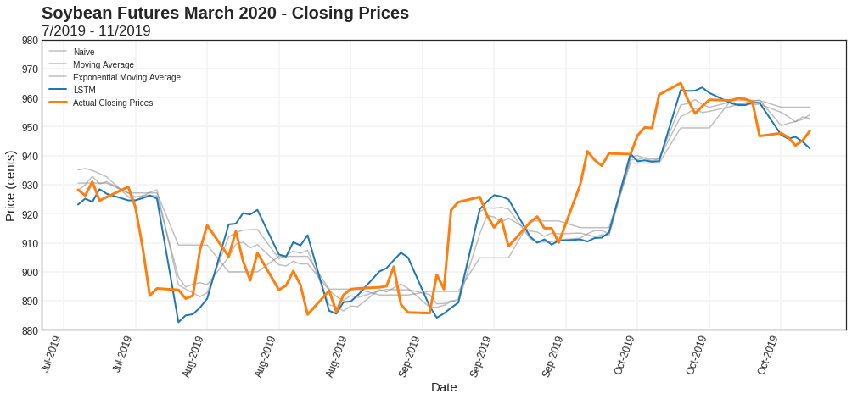
Models
METHOD | NAIVE | MOVING AVERAGE (MA) | EXPONENTIAL MA | LSTM | SARIMA | FINAL
MAE/week | 48.8 ¢ | 42.6 ¢ | 43.6 ¢ | 46.9 ¢
Notes:
We came up with a baseline naive model ( averaged the prev week as the price of the next week)
Our models tried to minimize the MAE Loss over the 3 months
*insert formula*
LS
We then improved on this through
MA,
EMA (noise),
SARIMA,
LSTM
To see how good our models were, we tested it on 15 weeks from July 22 to Nov 1
* Insert graph on this model
* Correlation matrix*

Slide 17
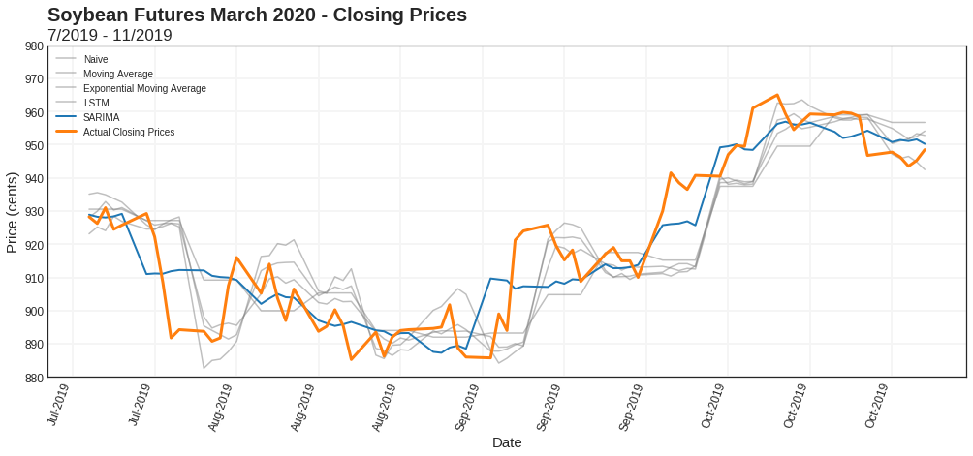
Models
METHOD | NAIVE | MOVING AVERAGE (MA) | EXPONENTIAL MA | LSTM | SARIMA | FINAL
MAE/week | 48.8 ¢ | 42.6 ¢ | 43.6 ¢ | 46.9 ¢ | 35.5 ¢
Notes:
We came up with a baseline naive model ( averaged the prev week as the price of the next week)
Our models tried to minimize the MAE Loss over the 3 months
*insert formula*
We then improved on this through
MA,
EMA (noise),
SARIMA,
LSTM
To see how good our models were, we tested it on 15 weeks from July 22 to Nov 1
* Insert graph on this model
* Correlation matrix*

Slide 18
PREDICTIONS
3

Slide 19
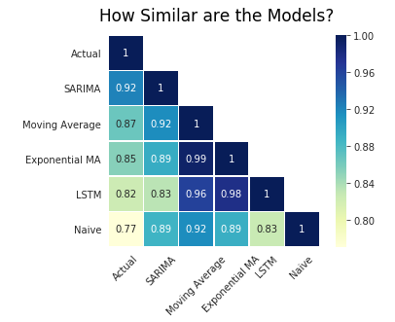
Ensemble Model
METHOD | NAIVE | MOVING AVERAGE (MA) | EXPONENTIAL MA | LSTM | SARIMA | FINAL
MAE/week | 48.8 ¢ | 42.6 ¢ | 43.6 ¢ | 46.9 ¢ | 35.5 ¢ | 34.4 ¢
MARCH
0.78 * SARIMA + 0.22 * LSTM
MAY
0.60 * SARIMA + 0.32 * LSTM + 0.08 * EMA
JULY
0.83 * SARIMA + 0.17 * LSTM
Notes:
We came up with a baseline naive model ( averaged the prev week as the price of the next week)
Our models tried to minimize the MAE Loss over the 3 months
*insert formula*
We then improved on this through
MA,
EMA (noise),
SARIMA,
LSTM
To see how good our models were, we tested it on 15 weeks from July 22 to Nov 1
* Insert graph on this model
* Correlation matrix*

Slide 20
Predictions
 | NAIVE | EXP MA | LSTM | SARIMA | ENSEMBLE
March 2020
May 2020
July 2020
Total MAE

Slide 21
CONCLUSION
4

Slide 22
Issues & Conclusion
Single Univariate Analysis
Are there systematic errors?
Contract Months for Prior Years ( 2019,2018…)
Notes:
Single Univariate Analysis
Volatility isn’t due to a single factor but a number of different factors (weather, government policies…)
Contract Dates for 2018,2017…
Fine Tuning Models
Black Swans?

Slide 23
Thank You!
Any questions?

Slide 24
Sources
https://www.marketwatch.com/investing/future/soybeans
https://www.cmegroup.com/education/articles-and-reports/naftas-impact-on-us-agriculture.html
https://robjhyndman.com/hyndsight/tscv/
Notes:
Single Univariate Analysis
Volatility isn’t due to a single factor but a number of different factors (weather, government policies…)
Contract Dates for 2018,2017…
Fine Tuning Models
Black Swans?

Slide 25
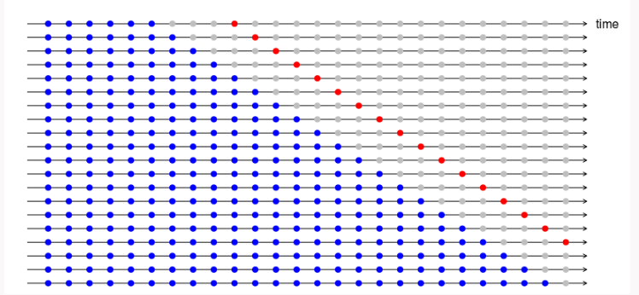
Time-series Cross Validation - Rolling Forecasting

Slide 26
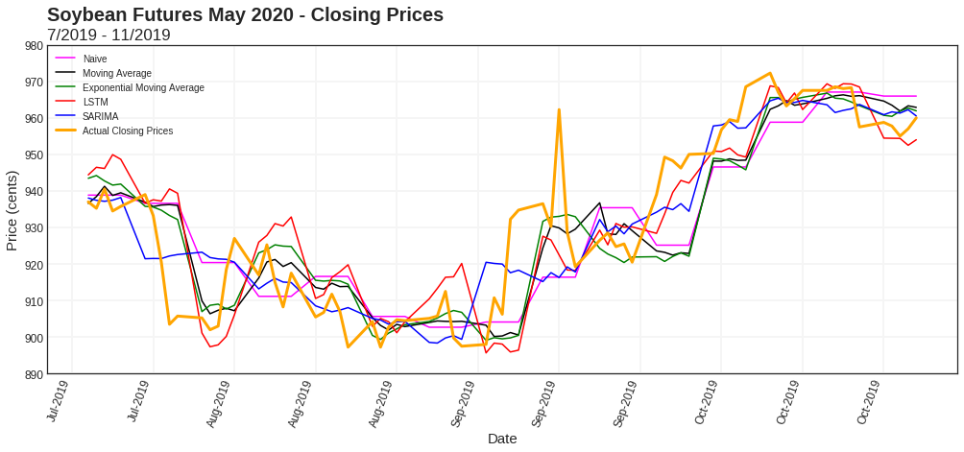
May 2020 Test Data Results

Slide 27
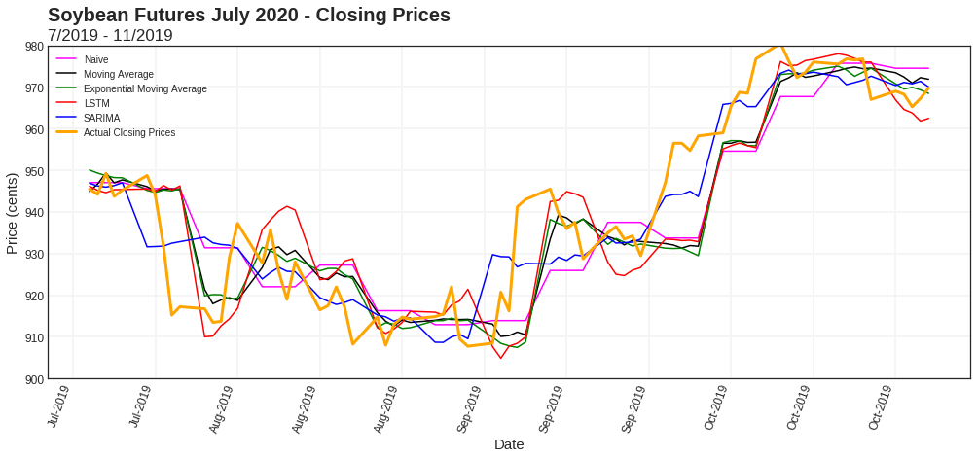
July 2020 Test Data Results

Slide 28
Non-Stationarity
Results of Dickey-Fuller Test for March:
p-value 0.174739
Results of Dickey-Fuller Test for May:
p-value 0.222584
Results of Dickey-Fuller Test for July:
p-value 0.208864

Slide 29
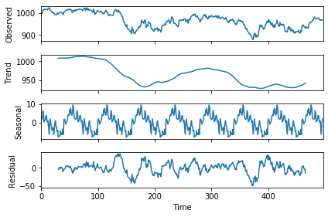
Time Series Decomposition
July contracts decomposition

Slide 30
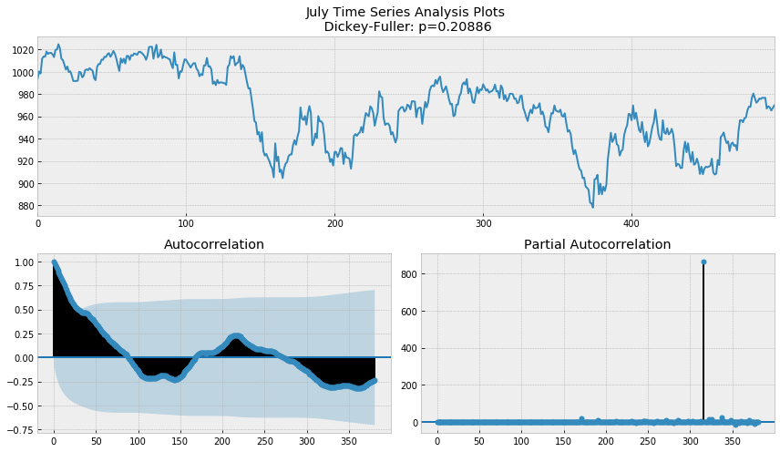
Seasonality

Slide 31
Finding weights for Ensemble Model

